Slide 1


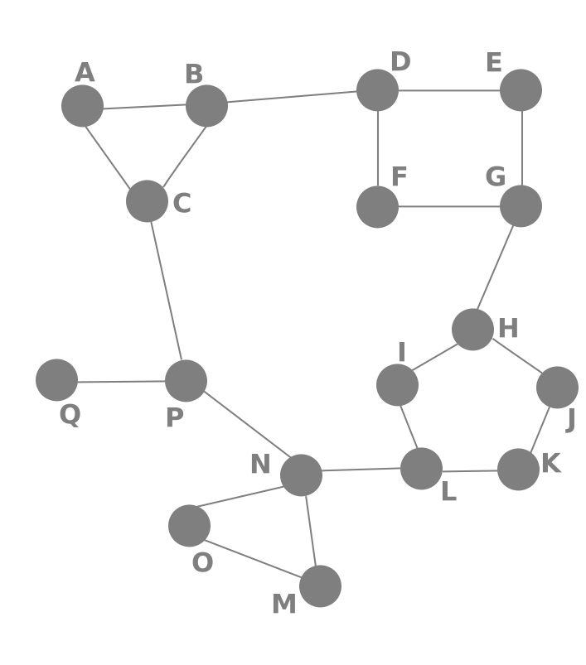


Routing and Architecture
Single Page Applications,
Blueprint for SPA
Routing
SoftUni Team
Technical Trainers
Software University
http://softuni.bg

Slide 2

Table of Contents
Routing Overview
React-router
Higher-Order Components
Code Organization Patterns
Thinking in React

Slide 3
Have a Question?
sli.do #react-js

Slide 4

Routing Overview
Navigation for Single Page Apps

Slide 5


What is Routing?
Routing allows navigation, without reloading the page
It's a pivotal element of writing Single Page Applications
Link
HTML
Router
Link
Link
Link
Standard Navigation
Navigation using Routing

Slide 6

Single Page Applications
A Router loads the appropriate content when the location changes
E.g. when the user manually enters an address
Conversely, a change in content is reflected in the address bar
E.g. when the user clicks on a link
Benefits:
Load all scripts only once
Maintain state across multiple pages
Browser history can be used
Build User Interfaces that react quickly

Slide 7

React-router
Routing Library Tailored for React

Slide 8
What is React Router?
React Router is a complete routing library for React
Keeps the UI in sync with the URL
const App = (<div>
<Route path="/catalog" component={Catalog}/>
<Route path="/about" component={About}/>
</div>);
ReactDOM.render((
<BrowserRouter>
<App />
</BrowserRouter>
), document.getElementById('root'))

Slide 9
Installation and Setup
Install using npm from the terminal
Import modules in your app
Official documentation
npm install --save react-router
import { BrowserRouter } from 'react-router-dom';
import { Route, Link } from 'react-router-dom';
https://reacttraining.com/react-router/web/guides/philosophy

Slide 10
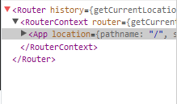
Rendering a Route
React Router is a component
It can be rendered as any React component
React components can be nested in it as normal
render(<BrowserRouter/>, document.getElementById('app'))
render((
<BrowserRouter>
<App />
</BrowserRouter >
), document.getElementById('app'))

Slide 11
Adding More Scenes
React components can be wrapped in a Route and bound to a specific path
Access URL
<Router history={hashHistory}>
<Route path="/" exact component={App}/>
<Route path="/catalog" component={Catalog}/>
<Route path="/about" component={About}/>
</Router>
Component to load

Slide 12
Navigating with Link
Link replaces <a> and automatically prevents page reload
class App extends Component {
render() {
return (<div><h1>React Router Tutorial</h1>
<Link to="/catalog">Catalog</Link>
<Link to="/about">About</Link>
</div>);
}
}
Access URL as defined in Route

Slide 13
Nested Routes
You can dynamically nest routes
const About = ({match}) => (
<div>
<h1>About Page</h1>
<Route
path={match.url + '/contact'}
component={Contact} />
</div>
)
Access match URL to
create a relative path
Contact will be rendered at '/about/contact '

Slide 14
Active Links
NavLink knows when it's currently active
We can style them with activeStyle or activeClassName
<NavLink to="/catalog" activeStyle={{ color: 'red' }}>
Catalog
</NavLink >
<NavLink to="/catalog" activeClassName="activeNav">
Catalog
</NavLink>

Slide 15
Exclusive Rendering
By default, if two Routes match, both will be rendered
Switch renders only the first match
<Switch>
<Route path="/" exact component={Home}>
<Route path="/about" component={About}/>
<Route path="/:user" component={User}/>
<Route component={NotFoundRoute}/>
</Switch>
Default route

Slide 16
URL Params
Parameters are dynamic parts of the URL
Example: /catalog/elecronics/XYZ5538
Configure the Route to work with params
Access from the component
This part of the URL can change
<Route path="/catalog/:category/:userId" component={Catalog}/>
this.props.params.category

Slide 17
Redirects
You can redirect the user by rendering a Redirect component
Determine the component to render at run-time
<Route exact path="/" render={() => (
loggedIn ? (<Redirect to="/dashboard" />)
: (<PublicHomePage />)

Slide 18


Routing with React Router
Live Demo

Slide 19



Higher-Order Components
Advanced Composition and Decoration

Slide 20

Higher-Order Components
A higher-order component (HOC) is a function that takes a component and returns a new enhanced component
An advanced composition pattern
Used by most third-party libraries (Redux, Relay, etc.)
const BoundForm = withBinding(Form, values);

Slide 21


Advantages
Greater code reuse
Reduced boilerplate
Easily handle cross-cutting concerns
Commonly used for:
Managing form input
Binding component props to business logic
Automating repetitive tasks

Slide 22
HOC Approaches
Avoid overriding methods
Pass unrelated props to the wrapped component
Extract props, related to the HOC
render() {
const { extraProp, ...passThroughProps } = this.props;
const injectedProp = someStateOrInstanceMethod;
return (
<WrappedComponent
injectedProp={injectedProp}
{...passThroughProps}
/>
);
}
Inject prop
Pass through the rest props

Slide 23
HOC Approaches (2)
Maximize composability with higher-order functions
Wrap the display name for easier debugging
function withSubscription(WrappedComponent) {
class WithSubscription extends React.Component {/* … */}
WithSubscription.displayName =
`WithSubscription(${getDisplayName(WrappedComponent)})`;
return WithSubscription;
}
function getDisplayName(WrappedComponent) {
return WrappedComponent.displayName ||
WrappedComponent.name ||
'Component';
}

Slide 24
Caveats
Don't use HOCs inside the render method of a component
A new class definition will be created on every rendering
Static methods must be copied
Or place them outside the component
Use external library
import hoistNonReactStatic from 'hoist-non-react-statics';
function enhance(WrappedComponent) {
class Enhance extends React.Component {/*...*/}
hoistNonReactStatic(Enhance, WrappedComponent);
return Enhance;
}

Slide 25

Programming Patterns
Organizing Your Code

Slide 26


Organizing Components
Always pass props to the parent class
Define default state
Event handlers are methods on the component
Bind event handlers at the end of the class constructor
Data is fetched in componentDidMount
Preform cleanup in comopnentDidUnMount

Slide 27

Organizing Applications
Try to use functional components whenever possible
Elevate shared state to the parent component
Use controller views for most of the business logic and data
Concentrate the state, event handlers and remote API calls
Use services and the observer pattern for cross-cutting concerns

Slide 28


Thinking in React
Start with a mock of the application
Use HTML+CSS, imaging software, a professional tool or just paper
Break the UI into a component hierarchy
Build a static version in React
Identify the minimal representation of UI state
Identify where your state should live
Add inverse data flow

Slide 29
Summary
React-router is a routing library tailored for React
HOCs can be used to reduce boilerplate code
React apps can be designed, following a specific algorithm
const App = (props) => (
<div>
<Route path="/catalog" component={Catalog}/>
<Route path="/about" component={About}/>
</div>
);

Slide 30







Routing and Architecture
https://softuni.bg/courses/

Slide 31

License
This course (slides, examples, demos, videos, homework, etc.) is licensed under the "Creative Commons Attribution-NonCommercial-ShareAlike 4.0 International" license

Slide 32





Trainings @ Software University (SoftUni)
Software University – High-Quality Education, Profession and Job for Software Developers
softuni.bg
Software University Foundation
http://softuni.foundation/
Software University @ Facebook
facebook.com/SoftwareUniversity
Software University Forums
forum.softuni.bg

